Slide 1

A Comprehensive Analysis of Machine Learning Algorithms for Breast Cancer Classification Across Diverse Image Modalities
Group No: 15
Submitted by
20301175 Sabista Ifraj
23266026 Arpita Roy
23266033 Sania Azhmee Bhuiyan
23273009 Sohanoor Rahman
Department of CSE
BRAC University
RA: Humaion Kabir Mehedi
ST: Farah Binta Haque
1

Slide 2
BACKGROUND
Breast Cancer Overview:
Most common cancer in women globally.
GLOBOCAN, 2020 study reported 19.3 million cancer cases and 10 million fatalities in 2020.
Anticipated 2.3 million new cases of breast cancer in women, surpassing lung cancer.
Average death rate from breast cancer in women is 6.9%
International Agency for Research on Cancer (IARC) has reported a 66% rise in cancer-related mortality worldwide since 1960.
2

Slide 3
Why systematic review rather than ML model build up?
Already reached State of the Art technology
Most of the models are performing with 95% above accuracy
3

Slide 4
Our Research Overview
A review of a total of 40 papers from 2020-2023 from various well-known sources like Elsevier, IEEE, and Springer has been covered regarding breast cancer detection and classification.
The difficulties in diagnosing breast cancer and the researchers' answers have been systematically reviewed and analyzed.
Shortcoming identification regarding these papers and we have provided the probable solution for the real-world experiments, which will be beneficial for future research for the researchers along with giving insight to the doctors for better diagnosis and treatments.
The main goal is to enhance breast cancer detection and diagnosis by using this systemic review based on data extraction, feature selection, imaging modalities, and numerous machine learning algorithms.
4

Slide 5
Challenges and limitations of current works
Hard to interpret due to interference of other tumor suppressor genes.
Dataset imbalance, inaccuracy, size, and computing efficiency.
Models scalability issues such as considering only particular models.
Not developing accurate algorithms instead of only using old models.
Limiting the generalizability such as not considering other datasets except particular datasets, only exploring machine learning(ML) approaches and not exploring other potential techniques, etc.
5

Slide 6
Research Question
RQ1: How datasets were collected and what are the common datasets used for machine learning and deep learning-based breast cancer detection?
RQ2: What are the image modalities like mammography, ultrasound, magnetic resonance imaging (MRI), and digital breast tomosynthesis? Which models are best aligned with these modalities?
RQ3: Which ML and DL algorithm works better? What algorithm works better along with which kind of dataset? Can we connect it in real-time?
6

Slide 7
How datasets were collected and an idea of how and What are the common datasets used for machine learning and deep learning-based breast cancer detection?
Most researchers used well-established datasets in their studies like WDBC, MIAS, DDSM, WBCD
Few researchers have created their datasets, which they have collected from Cancer hospitals
Common datasets that most researchers and practitioners use are from WDBC, MIAS.
WDBC is called the Wisconsin Breast Cancer dataset.
Consist of numerical features from the analysis of cell nuclei in digitized images of fine needle aspirates (FNA) of breast masses.
Does not include any modalities
MIAS is called Mammographic Image Analysis Society
Consist of Mammographic image
Consist of 332 mammographic images as of today
There are other well-known datasets available and used by many researchers.
7

Slide 8
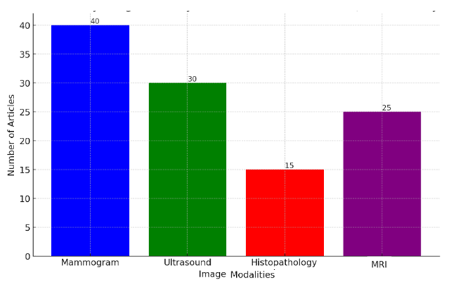
What are the image modalities like mammography, ultrasound, magnetic resonance imaging (MRI), and digital breast tomosynthesis? what are the most common ones?
Mammogram:
Most prominent modality with 41 articles.
Signifies widespread use and significance in breast cancer diagnosis and research.
Ultrasound:
Second most focused modality with 30 articles.
Emphasizes its importance in breast cancer screening, especially for younger women or those with dense breast tissue.
MRI:
Less common but crucial, with 25 articles.
Primarily used for detailed imaging, particularly in high-risk patients.
Histopathology:
Significant usage, evidenced by 15 articles.
Plays a crucial role in detailed tissue analysis for cancer diagnosis.
8

Slide 9
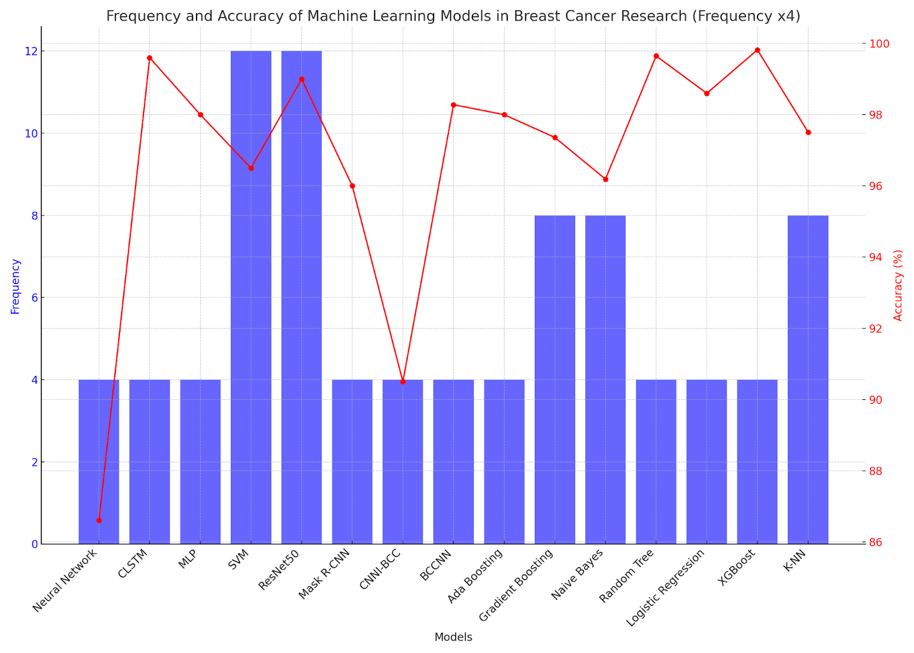
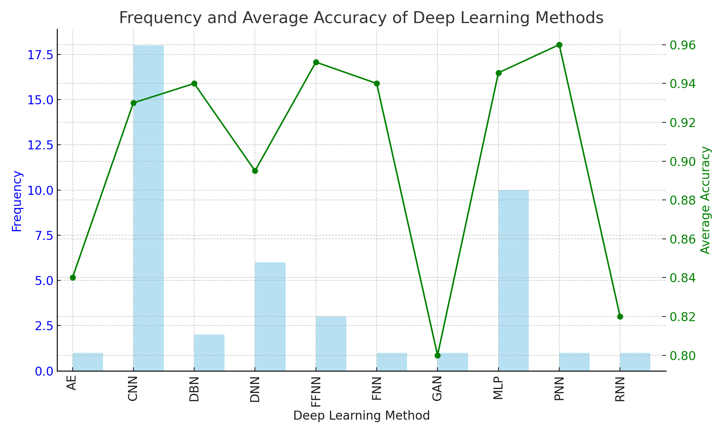
Which model performs better? And with What kind of dataset?
We did an overview of diverse papers, and found out Deep learning models might perform better (left side)
Then narrowed down and saw more papers on deep learning and found our CNN architecture perform better (right side)
9

Slide 10
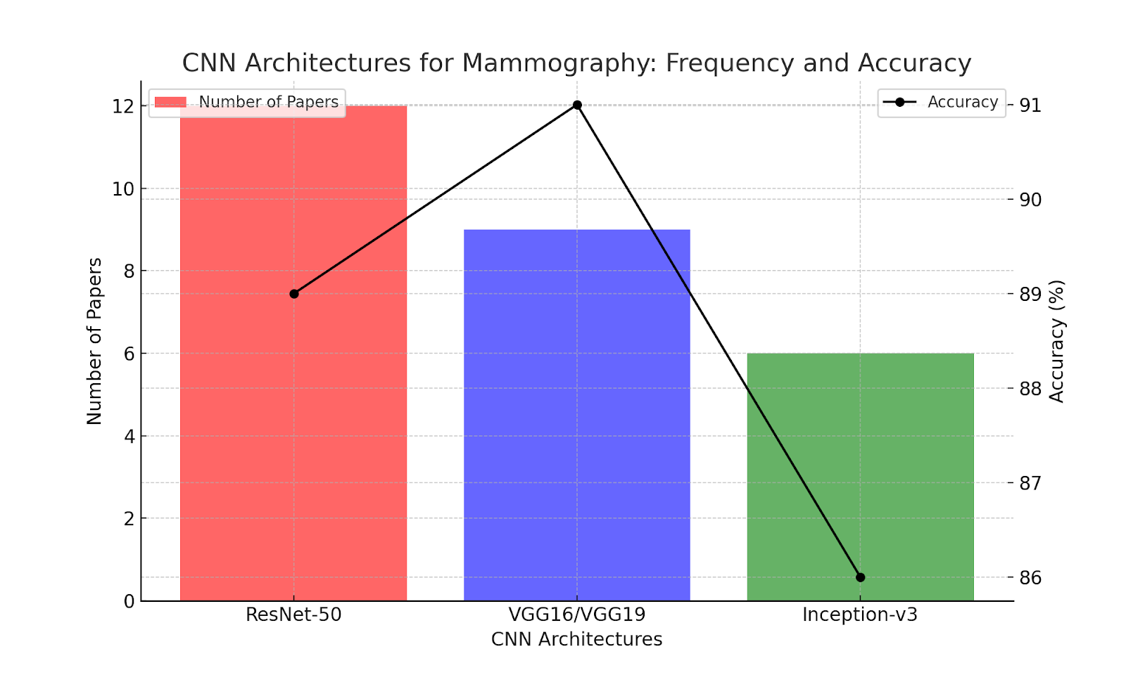
Which Machine learning algorithms work better on what
kind of image modalities?
Since CNN architectures work better than feature extraction then applying ML algorithms.
We narrowed down papers related to CNN architectures and did thorough research on ResNet-50, VGG-16/19, Inception-v3, Xception, MobileNetV2, DenseNet-121, AlexNet.
We went through around 40 papers and found out what kind of CNN architectures work best on what type of image modalities.
Mammography:
VGG16/VGG19:
Adept at capturing spatial hierarchies in mammography images.
Deep enough to learn complex patterns with a uniform and modifiable architecture.
Proven robustness in various image recognition tasks.
ResNet-50:
Introduces residual learning crucial for training deeper networks.
Propagates features without degradation, essential for subtle differences in mammography.
Effective in learning fine details and variations in tissue density.
10

Slide 11
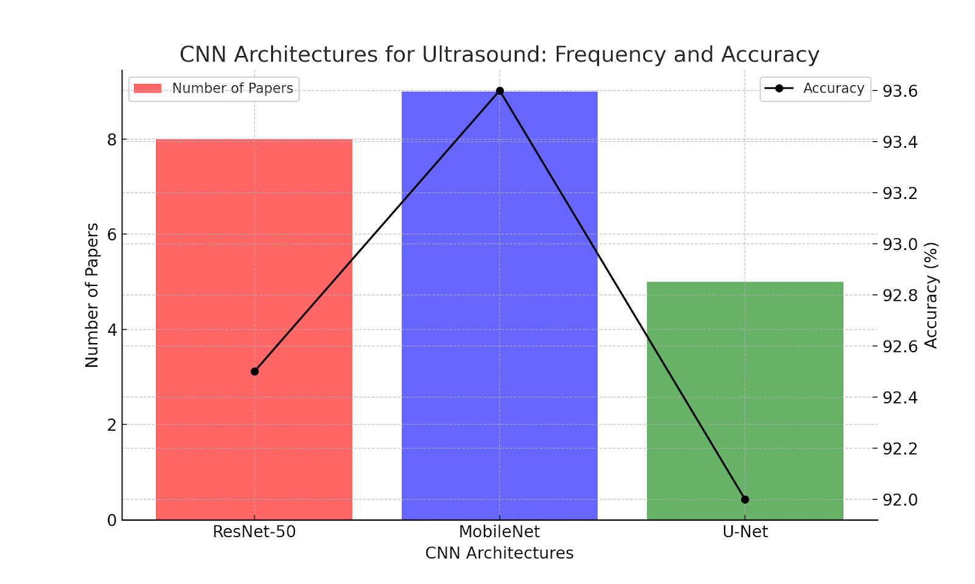
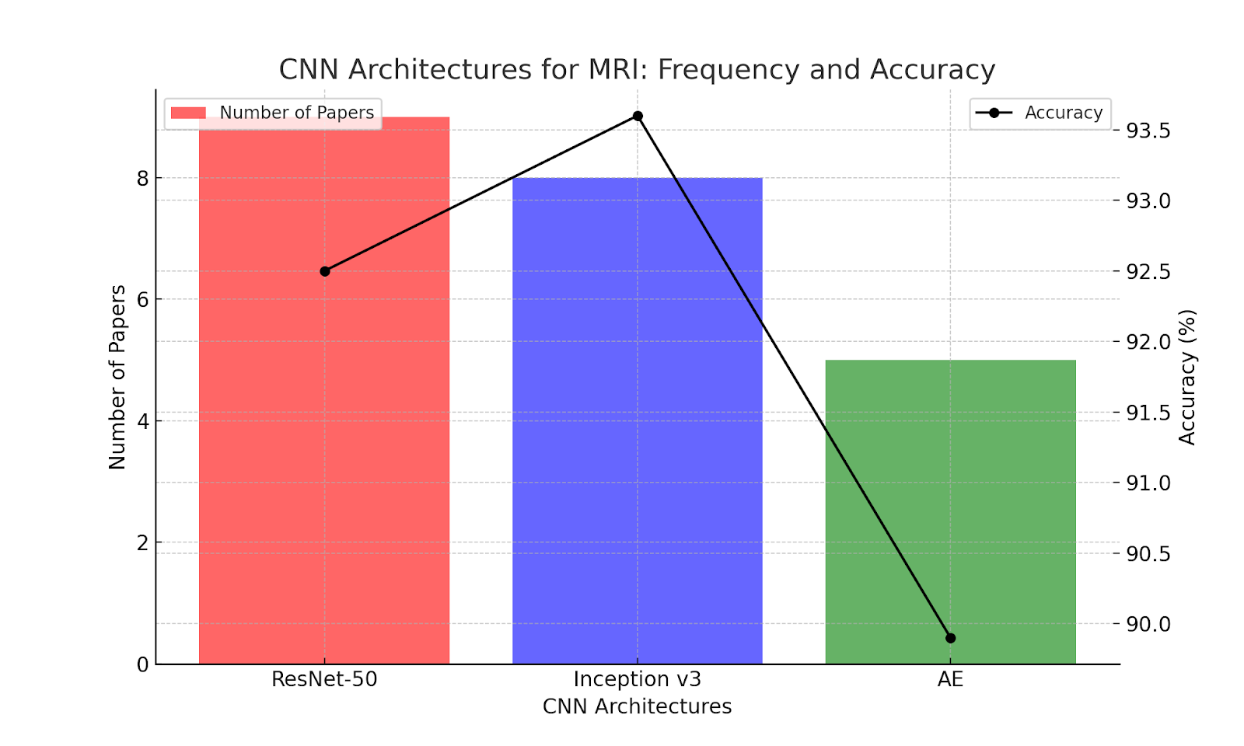
Ultrasound:
U-Net:
Suited for ultrasound due to its symmetric expanding path for precise localization.
Effective in handling speckle noise and blurred boundaries in ultrasound images.
Ideal for distinguishing between benign, malignant, and normal findings.
MobileNet:
Efficient for scenarios with computational constraints or real-time analysis.
Lightweight architecture for portable ultrasound devices.
Enables quick and efficient image processing without a significant drop in accuracy.
MRI:
Autoencoders (AE) :
excel at capturing latent features and patterns within data
ability for unsupervised dimensionality reduction is crucial, enabling the model to represent the essential information in a compact form, facilitating better analysis and interpretation
Well-suited for exploiting the full spatial context of the data.
Inception-v3/Inception-ResNet:
Composed of modules performing convolutions of different sizes concurrently.
Beneficial for diverse MRI data, adapting to varying feature relevance.
Flexible and powerful approach to capturing discriminative features for classification.
11

Slide 12
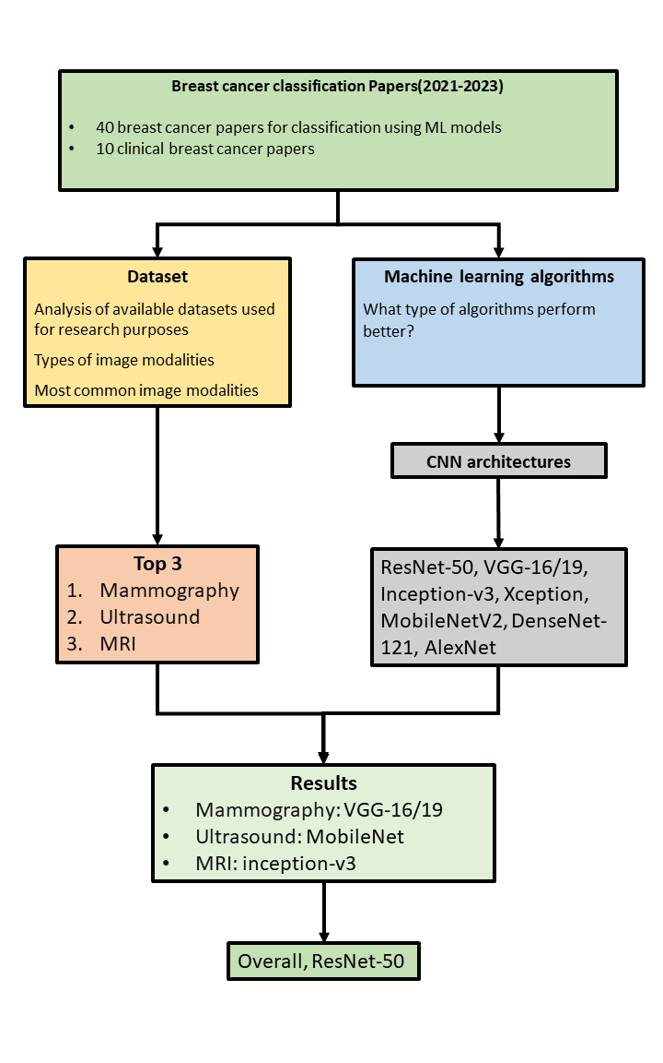
Methodology
12

Slide 13
Limitations:
Many studies use limited datasets, not fully representing the spectrum of breast cancer cases.
Lack of ethnic and demographic diversity in datasets, affecting generalizability.
Different imaging modalities lead to variable image quality, impacting model accuracy.
Most datasets were pre-processed; only about 20% of studies used their own collected datasets.
Research focused solely on image classification, narrowing the scope of findings.
13

Slide 14
Future Work
Future Work
Future research should include non-English papers and cover more geographical regions.
Examine papers with real-world model implementations for feasibility, scalability, and patient impact.
Opportunity for future research to utilize attention mechanisms to improve deep learning model precision.
Model Evaluation: Resnet 50 shows promise across major image modalities; future work should explore sector-specific models.
14

Slide 15
Thank you
15

